Slide 1
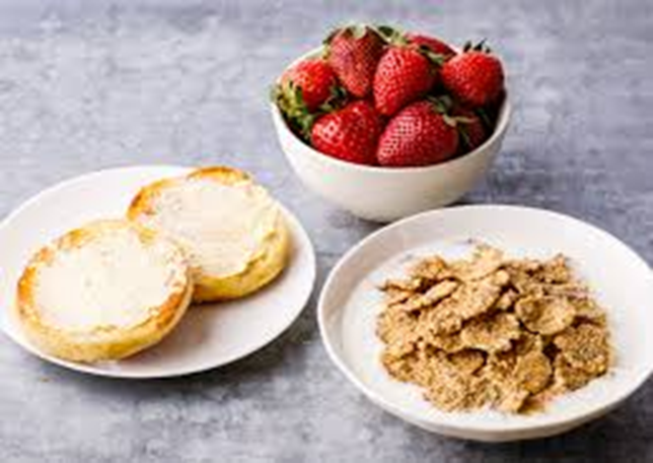
Attendance and Punctuality
The school day starts at 8.25am
First two lates in a term - break detention, failure to attend or turning up late or with food will result in a lunch detention
Third late - loss of break and one hour after school detention each time for the remainder of that term
Arriving after the registers have closed - without a valid reason will be considered as truancy and is logged by year leader as a negative point
FREE BREAKFAST from 7.30am for all

