Slide 1
Monday 19th July 2:30-3:30

Slide 2
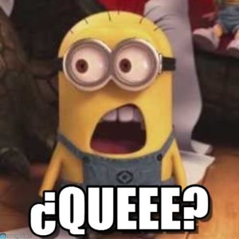

Slide 3
What is the BWA Spanish Spelling Bee?
The Spanish Spelling Bee is a spelling competition in……Spanish?
You will be given words that you have learnt during your Spanish lessons and spell them using the Spanish alphabet.

Slide 4
How will the BWA Spanish Spelling Bee work?
During your Spanish lessons you will be revising the alphabet (you can get a head start as the alphabet is already in your Spanish books!)
Then in 2 x form times you will be practicing using the alphabet to spell words in Spanish.
In the second form time you will complete a mini spelling bee to find your form finalist.
Your form finalist will then be entered into the Spanish Spelling Bee Final which will take place during an extended AOW the final week of term!

Slide 5
Who will participate in the the BWA Spanish Spelling Bee ?
Todos los años 7s!! EVERYBODY!!!!!!!
During your form time and lessons you will all be revising the alphabet and practise spelling Spanish words.
Everyone will take place in the mini Spanish Bee during form time.
The form Spelling Bee champions will then be entered to the final!
Even if you are not the finalist – they will still need all your support at the final!

Slide 6
When will the BWA Spanish Spelling Bee take place?
Fechas importantes!!
21st June - This week you will start to revise the Spanish alphabet during your Spanish lessons.
28th June – Next week you will practise the Spanish alphabet during one of your form times with your tutor.
5th July - The following week your form tutor will be completing a mini spelling bee during form time with you.
19th July - The winner of the form time spelling bee will then start to prepare for the for the final on Monday 19th July in AOW (your form will also need a reserve!)

Slide 7
Why are we doing a Spanish Spelling Bee ?

Slide 8
Why are we doing a Spanish Spelling Bee ?
Learning the phonetics of the Spanish alphabet is so important to help with the pronunciation of Spanish words!
También – what’s better than learning another language and having fun whilst you’re doing it!

Slide 9
PREMIOS!
There will be prizes for the winner and for the runners up!!

Slide 10
PREGUNTAS!
Any questions?
Miss Drechsler will be coming round form times during the next couple of weeks so you can ask her questions then or email her!
Alternatively – you can ask your Spanish teacher for more info!

